Slide 1

Capstone Project
Best Mexican Restaurant Expansion Suggestions From Foursquare Data

Slide 2
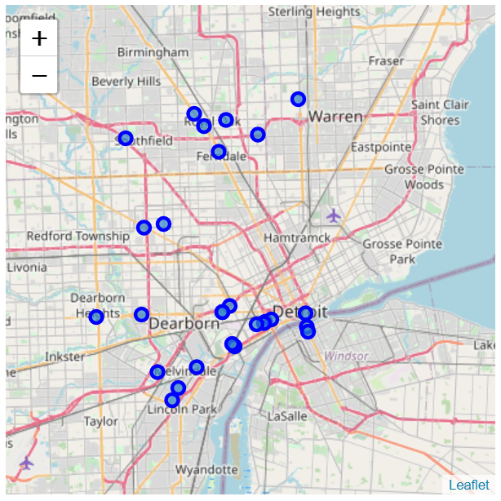
Foursquare Data
Detroit Mexican restaurant locations

Slide 3
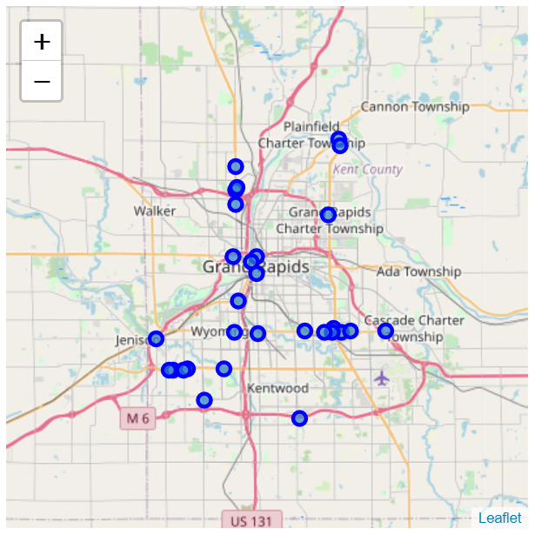
Foursquare Data
Grand Rapids Mexican restaurant locations

Slide 4
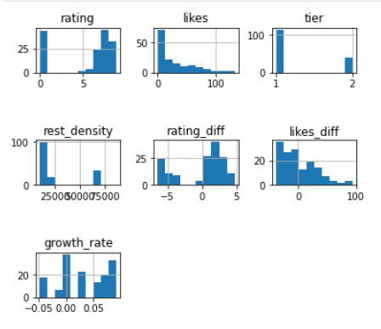
Analyzing Individual Feature Patterns Using Visualization

Slide 5
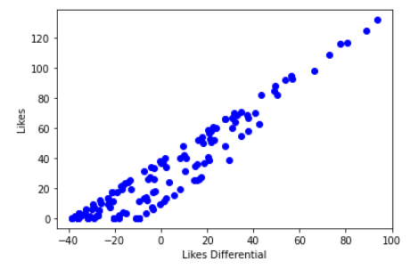
Scatter plot for Likes Differential independent variable and the likes dependent variable

Slide 6
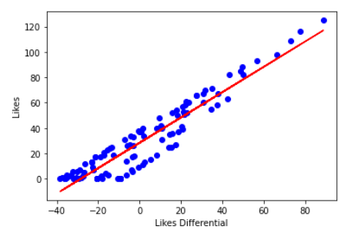
Scatter single linear regression plot for Likes Differential independent variable and the likes dependent variable

Slide 7
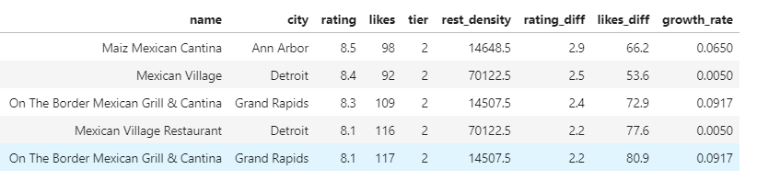
Suggested Target Mexican Restaurants

